Slide 1
CCSSD PROJECT PRESENTATION
GROUP 4
HASAN NURUDDIN BIN DERMAWAN LUKMAN NURHAKEEM BIN SHAHALAN NORAFIQAH AIMAN BINTI SUDIRMANTO MOHAMAD HAZEM BIN TAJULARIPIN

Slide 2
AGENDA
Introduction
Objectives
Target Audience
Pros and Cons
Hardware Requirements
Software Requirements
UI/UX
Authentication And Security

Slide 3
INTRODUCTION
Car Rental is a CMS platform where users can browse listing of rental cars, rent provider can add content, and perform a calculation for a price of rental rate. This system is developed by using Java with framework Springboot connected to MySQL for user login and database.

Slide 4
objectives
To make a seamless website that let customer choose what they want according to their budget
To implement transparency by showing the price of the rentals per day
To provide convenient interface where customer can focus on their needs
To provide easy and less time login process for customer

Slide 5
Target Audience
Tourists
Business Travelers
Students
Families
Needs temporary vehicle to explore new cities or regions
Reliable for outstation or events
Road trips or vacation during semester break
Holiday and vacations

Slide 6
Pros and cons
Limited human interaction
Competition and price comparison
Dependency on internet access
Possible miscommunication during booking process
Convenience and accessibility
Transparency and Trust
Efficient rental process
Easy and straightforward

Slide 7
hARDware Requirements

Slide 8
Hardware requirements
Windows 10 / MAC OS
16GB RAM and above
Solid-State Drive SSD
Stable network – 100mbps and above

Slide 9
Software Requirements

Slide 10
Software requirements
Impact factor | Measurement
Frontend Development | HTML, CSS, Javascript
Backend Development | Java, Springboot
Database | MySQL (Xampp)
Deployment Tools | GitHub, Eclipse, Apache Tomcat
Communication Channel | Zoom, Whatsapp

Slide 11

UI/UX
Car rental overview flow

Slide 12
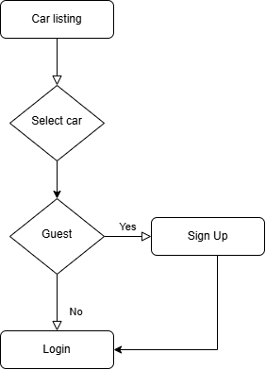
USER STORY
Method to gather requirement
As a user, I want to browse a car rental web application which I can choose variety of car listing and calculate the rate to tally with my budget. I want to browse as a guest that not require me to login or sign up but once I have one in my mind I want to sign up and login to make me feel safe with my data, can log out everytime I finished browsing

Slide 13

AUTHENTICATION AND SECURITY
Build save web application

Slide 14
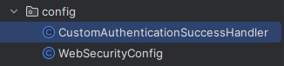
Create new package config that allow to organize, manage and customize as setup and arrangement of application.
Create java file to handle authentication and security;
CustomAuthenticationSuccessHandler
WebSecurityConfig
We also can enhance security via checking user credential like;
Checking duplicate email
Invalid password or username

Slide 15
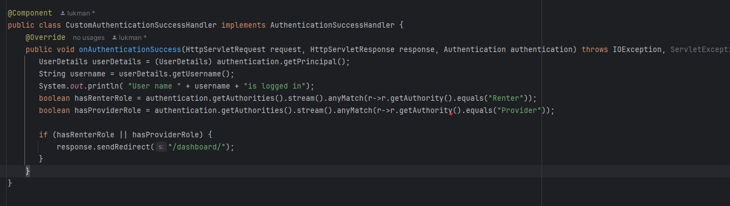
CustomAuthenticationSuccessHandler
Handle when user is registered and upon success login redirected to dashboard

Slide 16
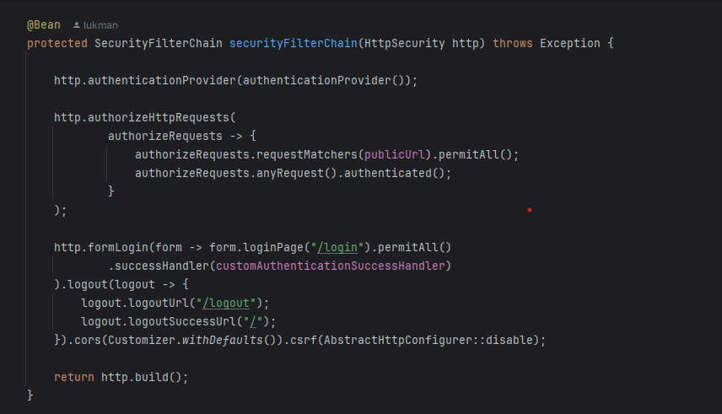
WebSecurityConfig
Prevent user from accessing the page through endpoint without login

Slide 17
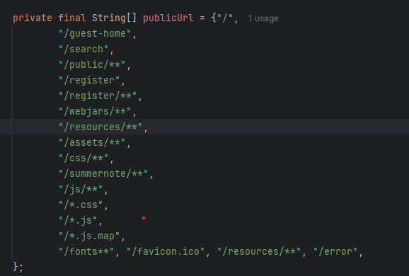
WebSecurityConfig
However, these can be access without login

Slide 18
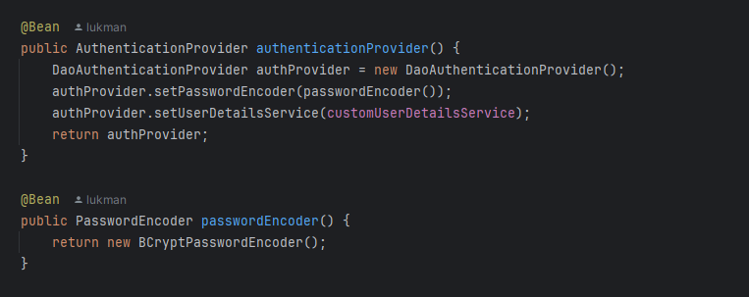
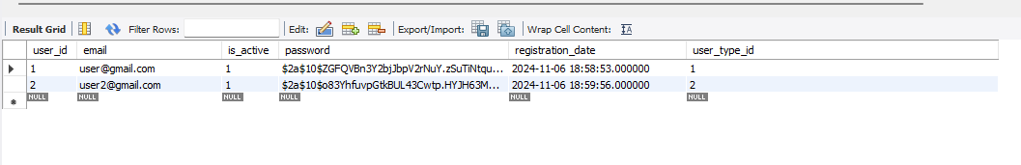
WebSecurityConfig
Encode the user password to enhance security

Slide 19
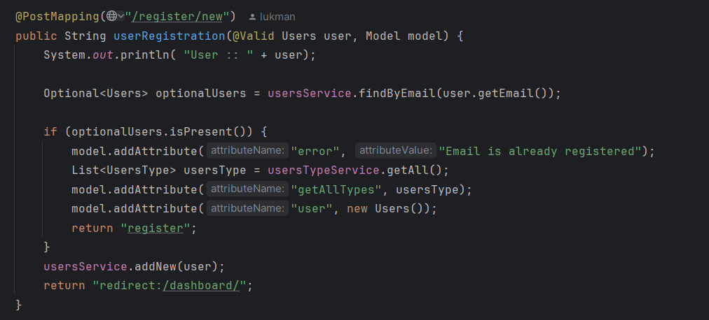
Duplicate Email
Checking email to prevent misuse of same email

Slide 20
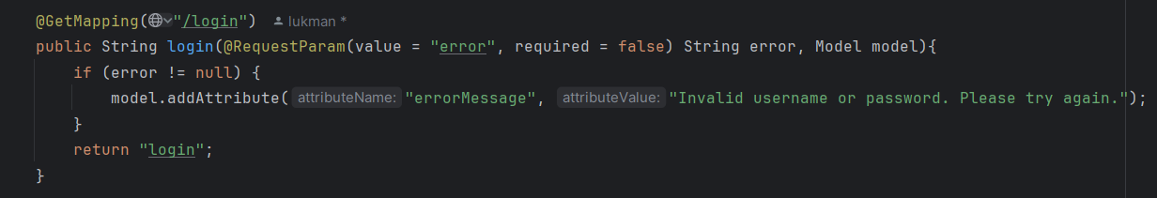
Checking Credential
User must use same email with correct password

Slide 21

ADD NEW CAR FUNCTION
To add car information and car picture

Slide 22
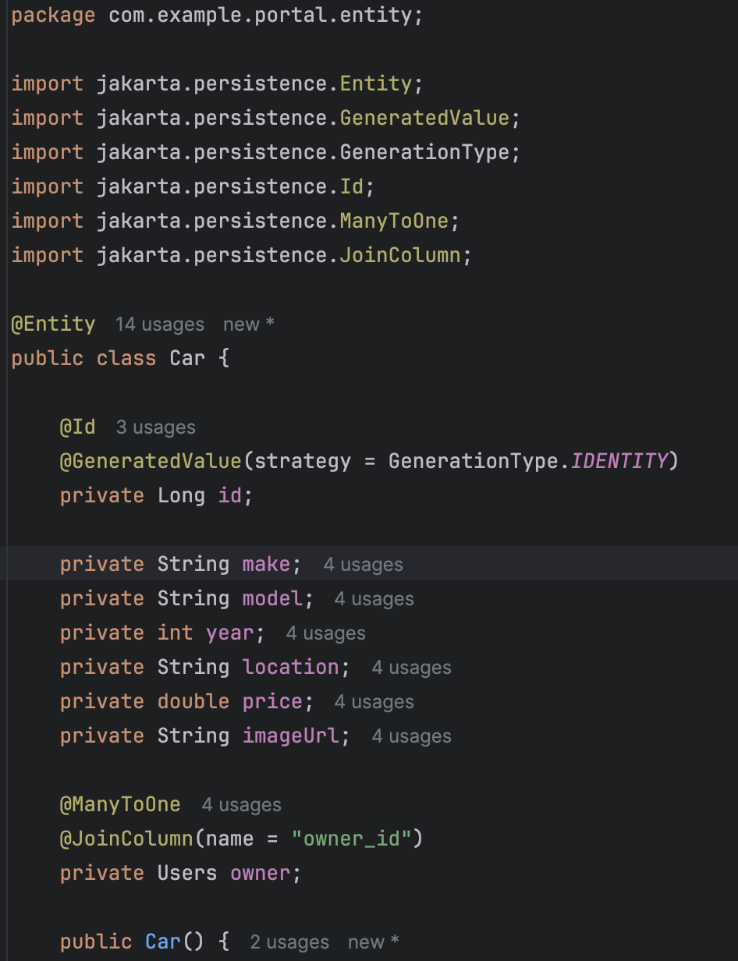
Car Entity
This is the entity class of Car that determines how the Car’s data is stored in the system.
It’s attributes include the ID, make, model, year, location, price and picture of the car.
All the variables in the Car entity are private following principle of encapsulation to avoid tampering of data.
It has a many to one relationship with the Users Entity

Slide 23
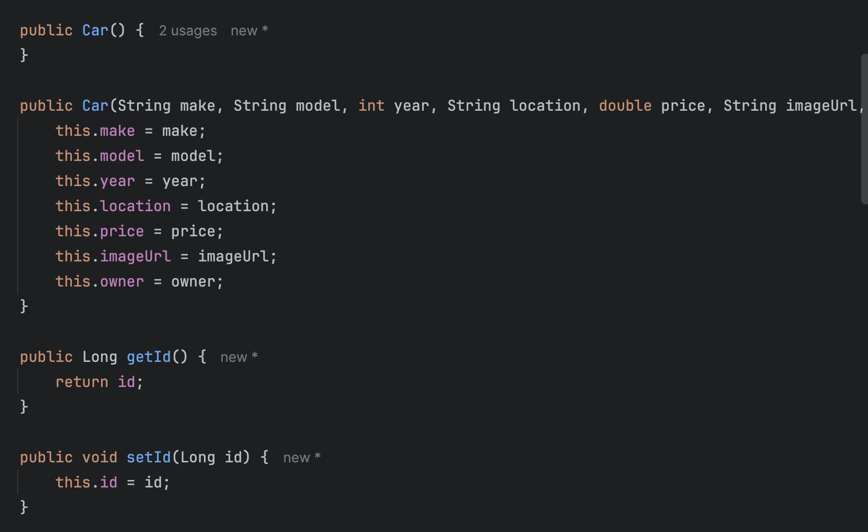
Car Entity
A constructor method is made and the variables are assigned the values when the object is created.
The variables can be accessed and changed using public getter and setter methods following encapsulation concept.

Slide 24
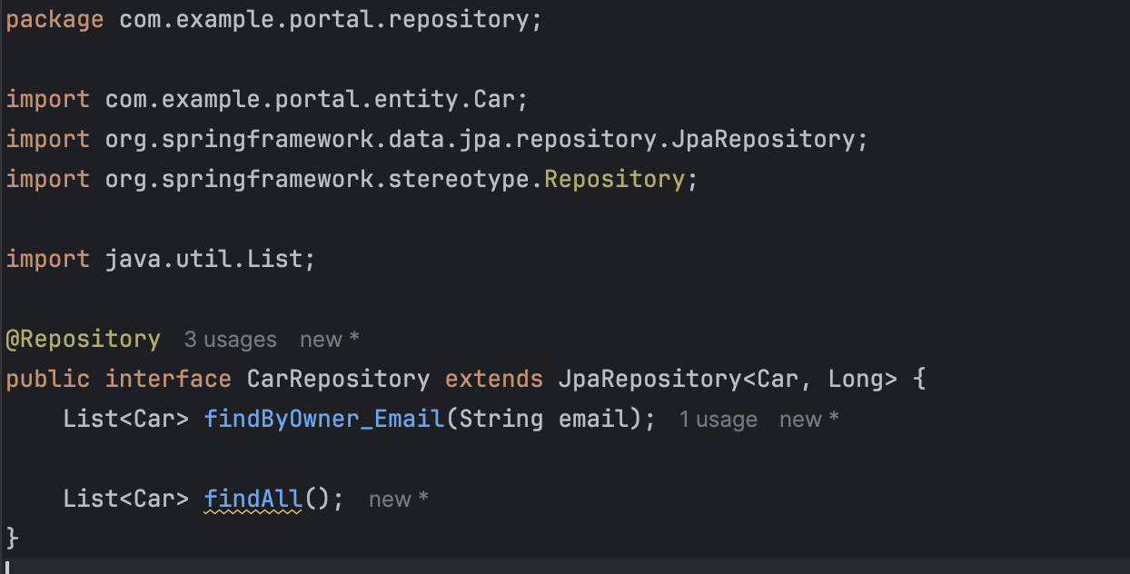
CarRepository
A CarRepository class is used to access the entities in the database
It is a subclass of JpaRepository which contains methods for CRUD operations.
This means that the keyword extends is used which reflect the inheritance concept.
The findAll() method is declared here to enable all the cars to show up in the dashboard.

Slide 25
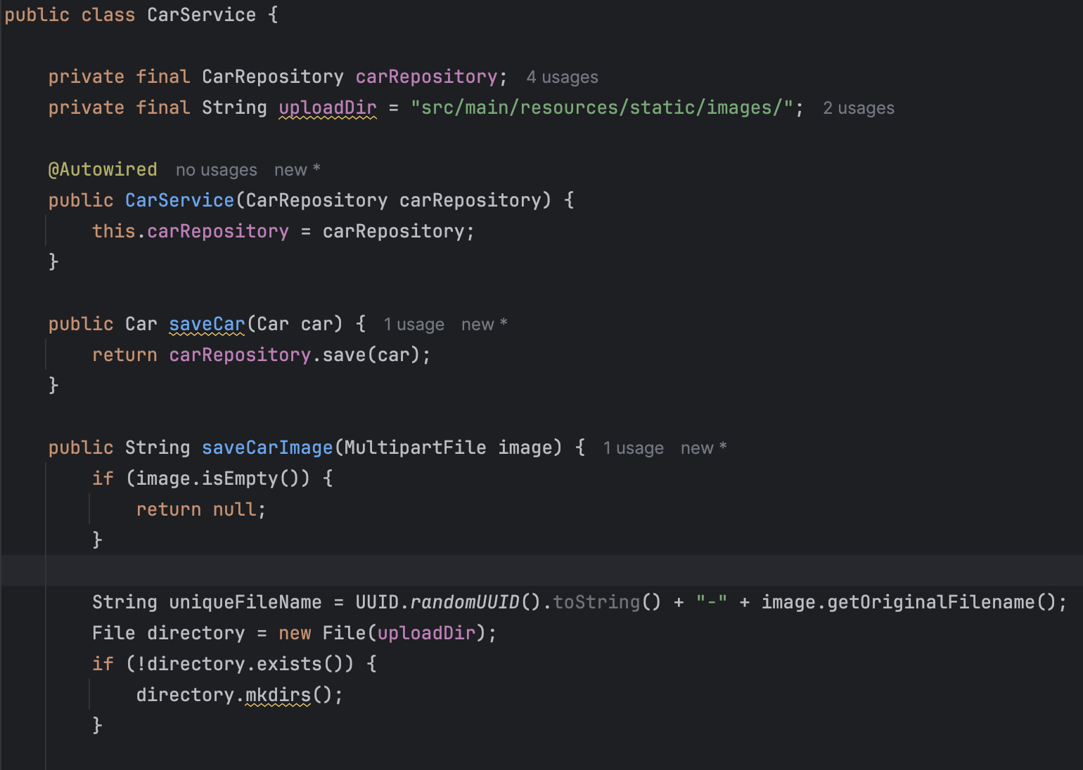
CarService
A CarService class is created to handle retrieving and saving the car’s information including its picture.
It imports the CarRepository to use the methods in it to access and modify the Car entity.

Slide 26
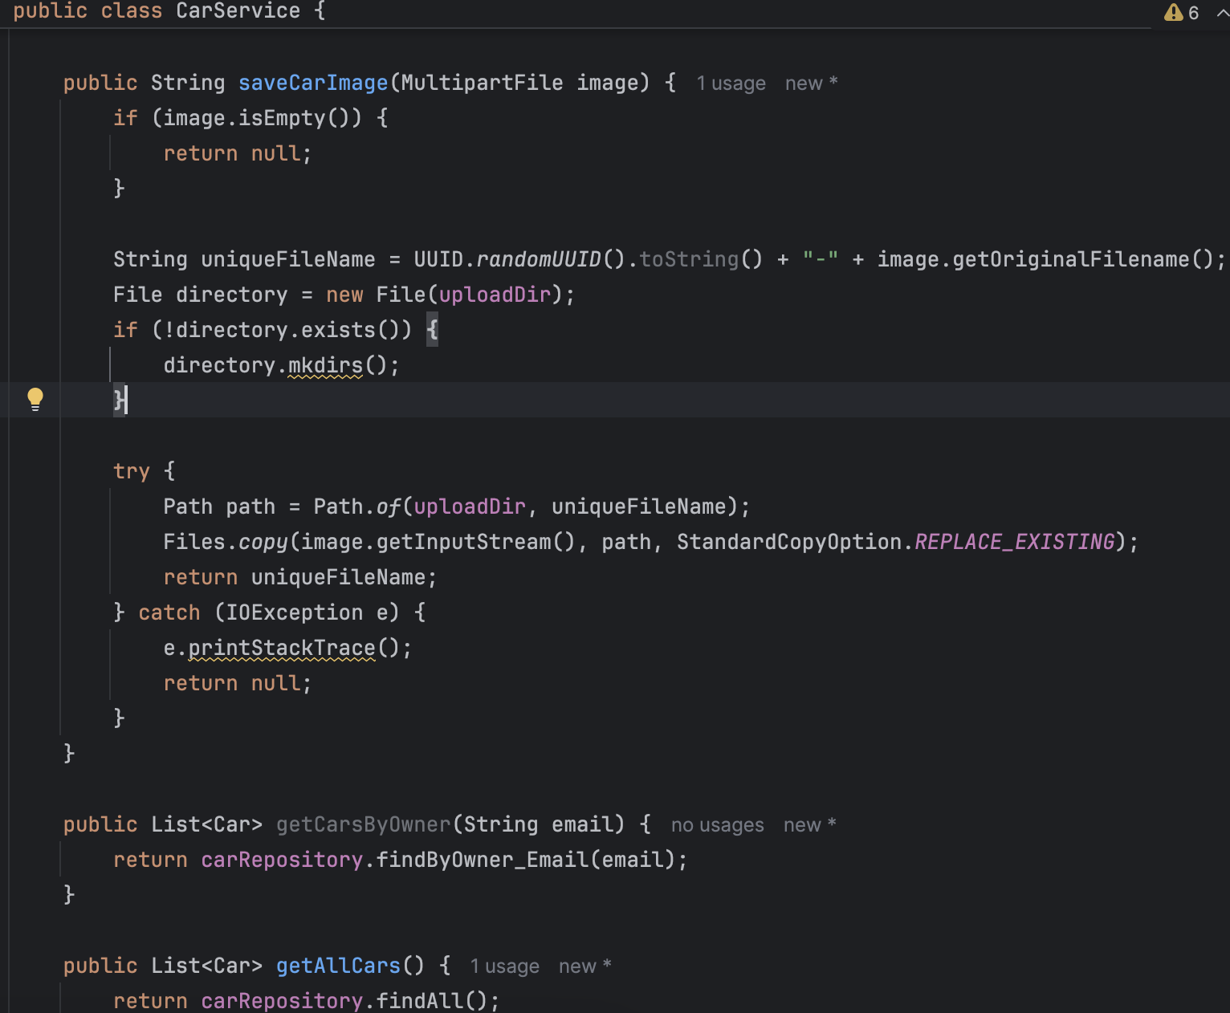
CarService
For saving the car’s image, a try-catch is set up to catch the exception when uploading image fails.
In this case, an IOException is caught and will print the stack trace, where method will return null.

Slide 27
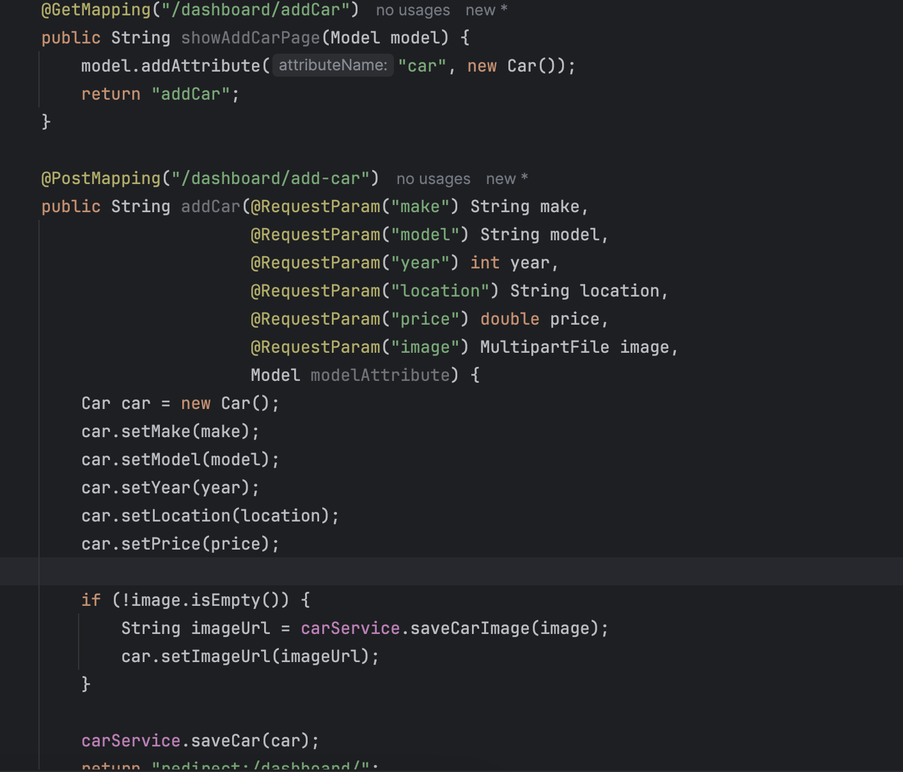
CarController
For the controller, a method is added to handle viewing the Add New Car page (GET) and adding the car when the user save/submit the form (POST).

Slide 28
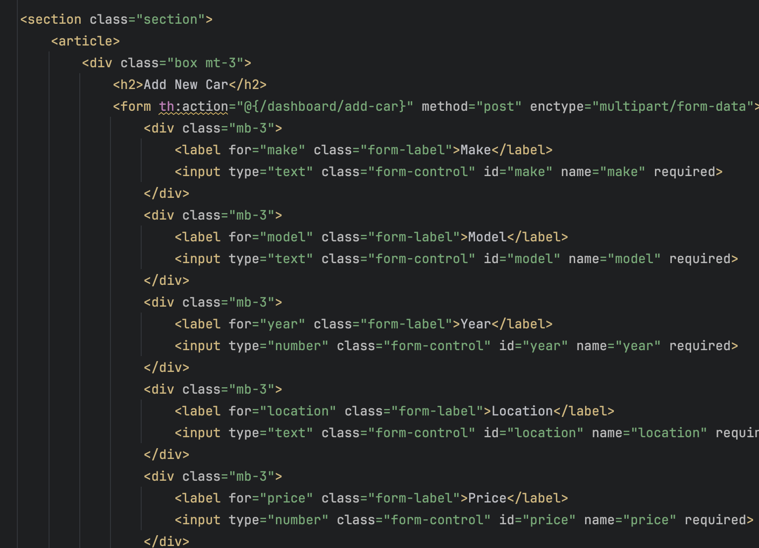
addCar.html
A HTML file for addCar is created to show the forms containing the fields needed to be filled in and the submit button to click to save the car information.

Slide 29
Car loan calculator
Add calculation for loan based on rate

Slide 30
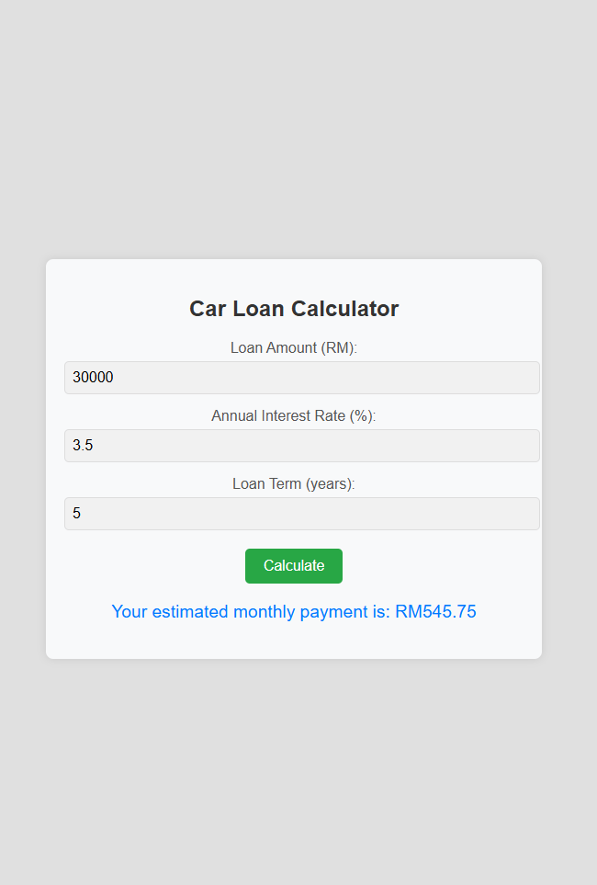
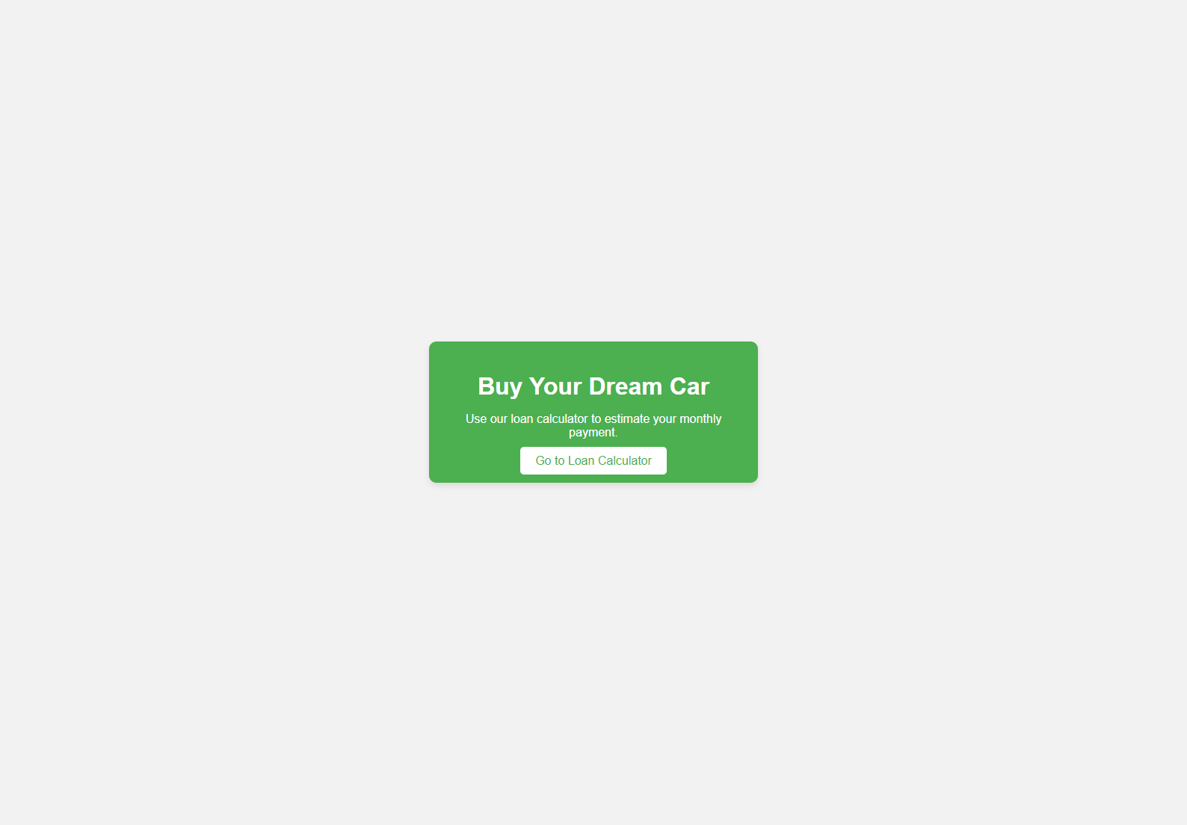

Slide 31
THANK YOU

